Slide 1
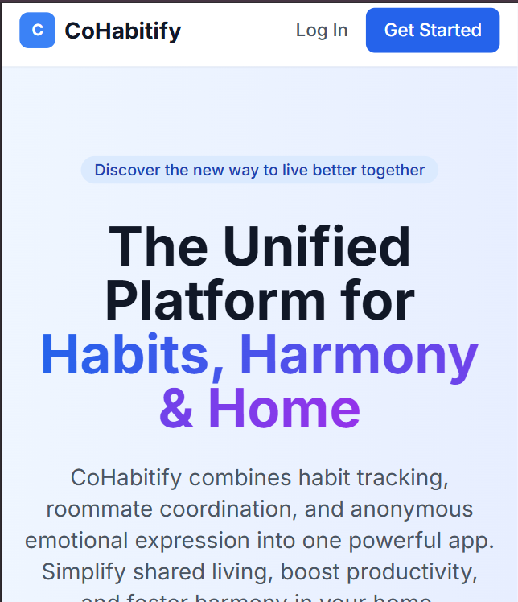

Cohabify – A cool app for room-mates
A smart platform for roommates to live, share, and grow together.
Developed by: Innovher Course: Back End Engineering-II - 23CS008 Instructor: Mr. Deepak Kumar

Slide 2

The Problem:
Living with roommates comes with challenges:
Splitting expenses fairly 💸
Coordinating chores & habits 🧹
Lack of transparency in contributions 😓
Miscommunication & conflicts 🗨
No safe space to share feelings 😶
Existing tools (WhatsApp, Excel, random apps) are disconnected and
not designed for roommates.

Slide 3




Our Solution – Cohabify
A web application built for roommates & shared living spaces. Combines habit tracking, expense management, and community bonding into one platform.
Transparency
Privacy
– no fights over money.
– anonymous sharing feature.
Consistency
Simplicity
– habits & chores tracked.
– easy-to-use dashboard.

Slide 4

The Vision
To create a Digital home hub for every shared living space.
Make co-living stress-free, fun, and collaborative.
Inspire roommates to build healthy habits, fair systems, and better relationships.

Slide 5
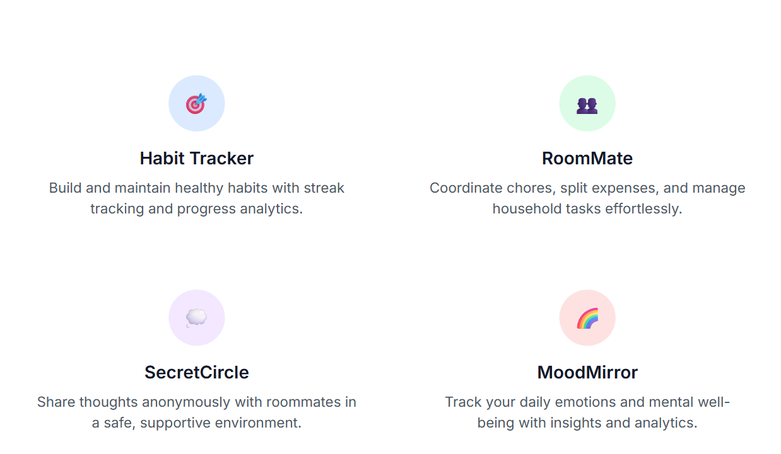
Key Features
Habit Tracker – track daily routines, earn streaks, compete with roommates.
RoomMateo – split expenses & chores automatically.
SecretCircle – safe anonymous sharing of moods & thoughts.
Dashboard – one place to see habits, expenses, and updates.
Notifications & Reminders – never miss payments/chores.

Slide 6


Target Users
The users we are targeting through this application are :
Students living in hostels / PGs
Young professionals in shared apartments
Friends/family members managing shared homes
Co-living spaces/startups offering community living services

Slide 7

Benefits :-
Reduces roommate conflicts 🏡
Builds accountability & discipline 💪
Saves time & money ⏳💸
Fosters community bonding 🤝
A single solution instead of multiple apps 📱

Slide 8















Technical Architecture: The MERN Stack
Frontend: React (Vite), Tailwind CSS.
Backend: Node.js with Express.js handling API logic.
Database: MongoDB Atlas via Mongoose for flexible data storage.
Deployment: Vercel for the frontend, Render for the backend, and MongoDB Atlas for the database.
Auth: JWT-based authentication

Slide 9
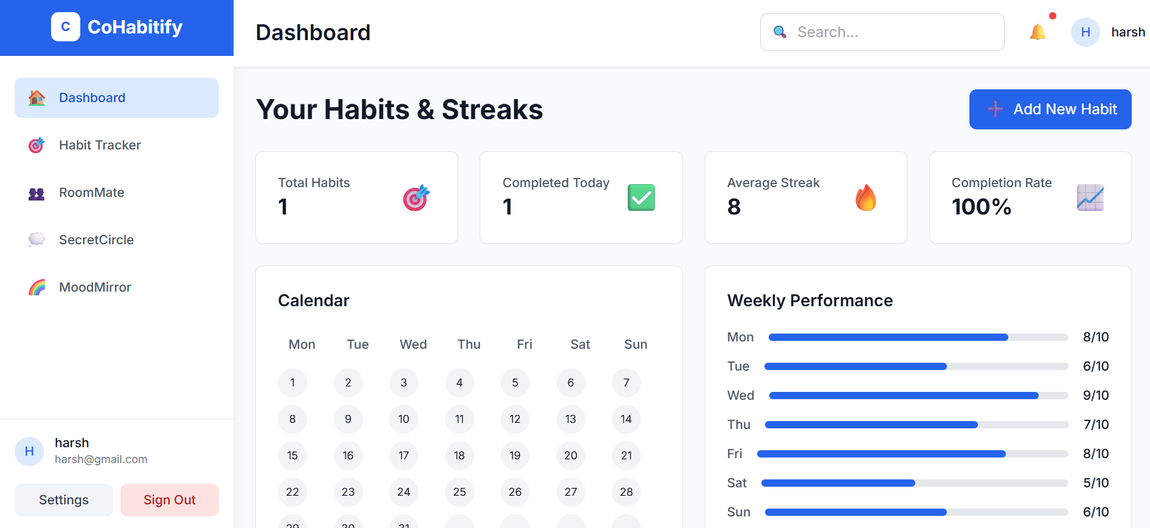
Future Scope :-
Now let’s check out the future scope for our project :-
Mobile app (React Native) 📱
AI-powered habit recommendations 🤖
Bill auto-splitting with UPI/Stripe integration 💵
Gamification (badges, points, rewards) 🏆

Slide 10

Conclusion :-
Cohabify makes shared living stress-free, fair, and fun.
It combines utility + community + privacy in one platform.
“Simplify life, together.” ✨

